Slide 1
Violent crimes Per Population & communities
Shon Mohsin and Laura Niederlander
26 July, 2018

Slide 2
Real World Stories
Correlation between Ethnicity, Income, Neighborhood, Education, and other factors play a role in who is impacted by Violent Crimes in our Community.
In the News ….
Top stores….
Worst Neighborhood for crime….
Media influence….
What can we determine from our research?

Slide 3
Data Defined
Many variables are included to weight attributes to be tested. Unrelated attributes were not included; attributes were picked if there was any plausible connection to crime (N=122), plus the attribute to be predicted (Per Capita Violent Crimes).
The variables included in the dataset involve the community, such as the percent of the population considered urban, and the median family income, and involving law enforcement, such as per capita number of police officers, and percent of officers assigned to drug units.
The per capita violent crimes variable was calculated using population and the sum of crime variables considered violent crimes in the United States: murder, rape, robbery, and assault.
There was apparently some controversy in some states concerning the counting of rapes. These resulted in missing values for rape, which resulted in incorrect values for per capita violent crime.
These cities are not included in the dataset. Many of these omitted communities were from the midwestern USA.
Notes:
Data Set Information:
Many variables are included so that algorithms that select or learn weights for
attributes could be tested. However, clearly unrelated attributes were not included;
attributes were picked if there was any plausible connection to crime (N=122), plus
the attribute to be predicted (Per Capita Violent Crimes). The variables included in
the dataset involve the community, such as the percent of the population considered
urban, and the median family income, and involving law enforcement, such as per capita
number of police officers, and percent of officers assigned to drug units.
The per capita violent crimes variable was calculated using population and the sum of
crime variables considered violent crimes in the United States: murder, rape, robbery,
and assault. There was apparently some controversy in some states concerning the
counting of rapes. These resulted in missing values for rape, which resulted in
incorrect values for per capita violent crime. These cities are not included in the
dataset. Many of these omitted communities were from the midwestern USA.
Data is described below based on original values. All numeric data was normalized into
the decimal range 0.00-1.00 using an Unsupervised, equal-interval binning method.
Attributes retain their distribution and skew (hence for example the population
attribute has a mean value of 0.06 because most communities are small). E.g. An
attribute described as 'mean people per household' is actually the normalized (0-1)
version of that value.
The normalization preserves rough ratios of values WITHIN an attribute (e.g. double
the value for double the population within the available precision - except for
extreme values (all values more than 3 SD above the mean are normalized to 1.00; all
values more than 3 SD below the mean are nromalized to 0.00)).
However, the normalization does not preserve relationships between values BETWEEN
attributes (e.g. it would not be meaningful to compare the value for whitePerCap with
the value for blackPerCap for a community)
A limitation was that the LEMAS survey was of the police departments with at least 100
officers, plus a random sample of smaller departments. For our purposes, communities
not found in both census and crime datasets were omitted. Many communities are missing
LEMAS data.

Slide 4
Dataset
Demographic information includes: (122 predictive, 5 non-predictive, 1 goal)
5 Non-Predictive
US State, County, Communities, Community Names, Fold
122 Predictive
Age, Ethnicity, Education, Income, Employment, Social-Eco Status, Household size, Marital status, Immigrants, language, Household dynamics, home ownership, living assistance, origin, Police presence, transportation, urban/rural, land density.
1 goal
Violent Crime Per Population

Slide 5
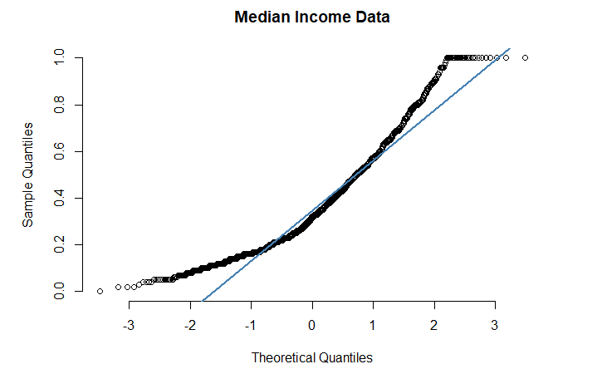
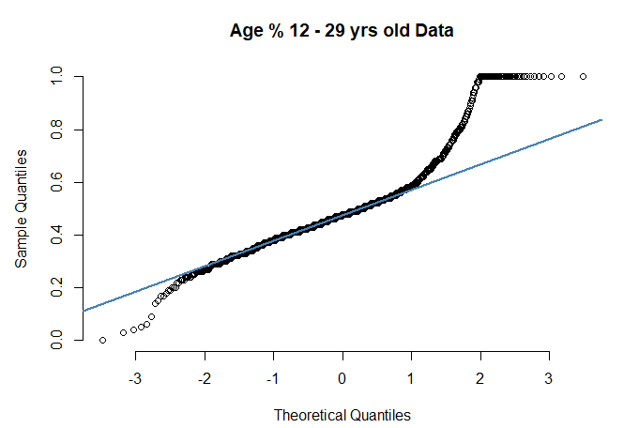
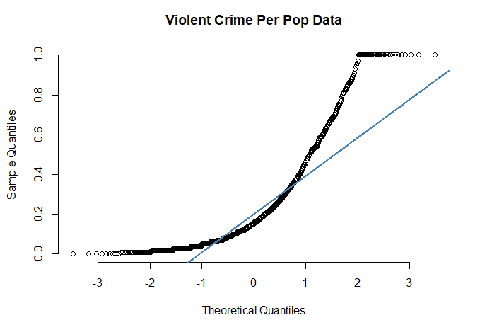
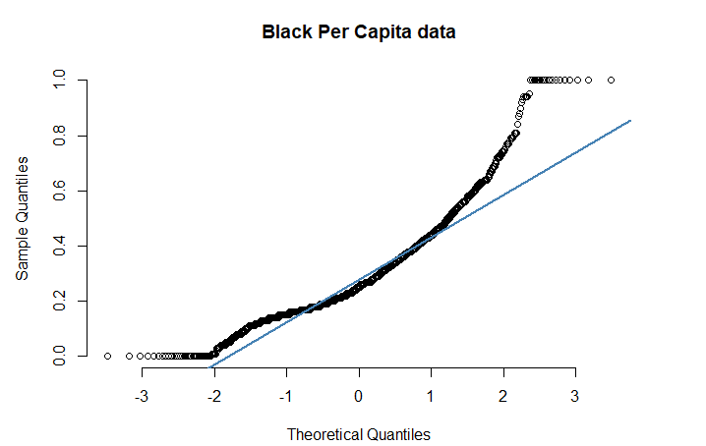
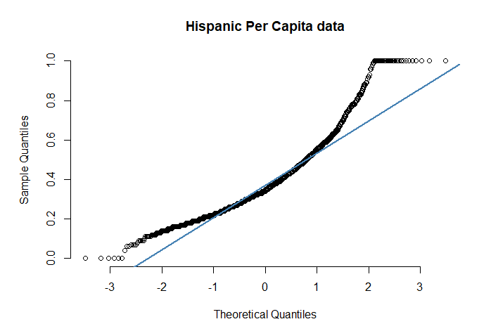
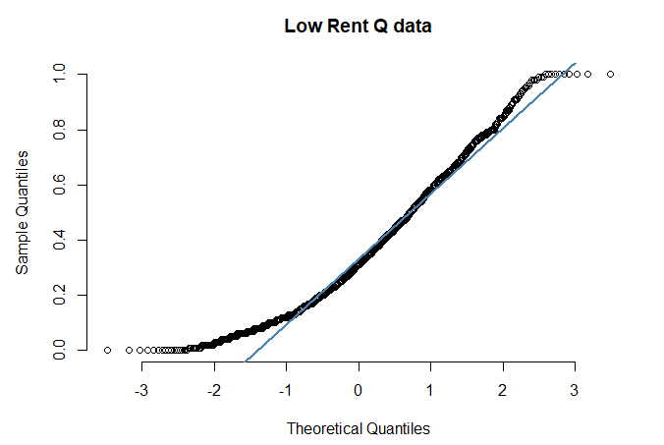
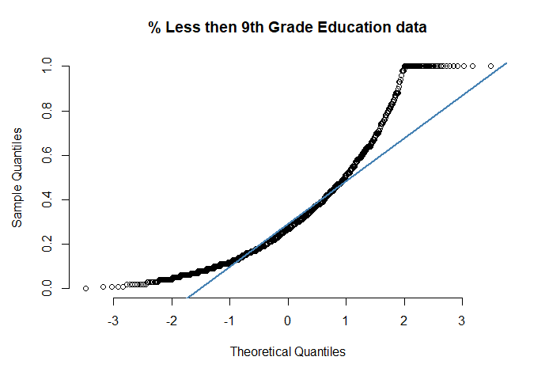
Check for Linearity
Notes:
#Check for linearity
qqnorm(cdss$crimedata.ViolentCrimesPerPop, pch = 1, frame = FALSE, main= "Violent Crime Per Pop Data") ## plots the data qqline(cdss$crimedata.ViolentCrimesPerPop, col = "steelblue", lwd = 2) ## adds a line

Slide 6
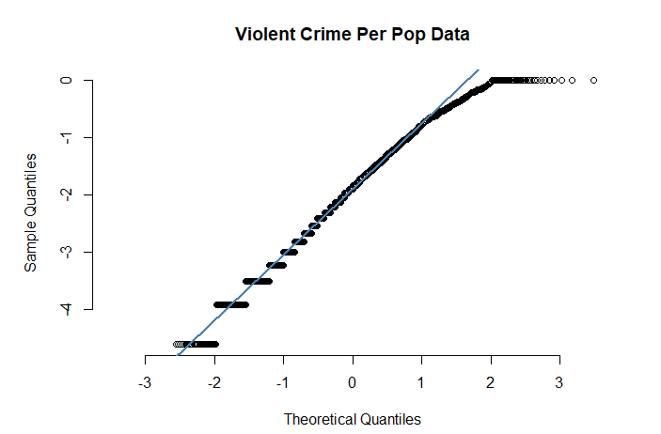
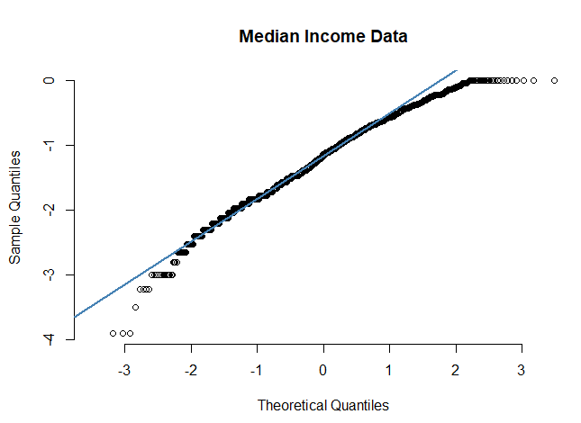
Log Transform

Slide 7
Define predictors and goals
Goal
-- Total number of violent crimes per 100K population
Predictive
-- Education Levels
-- Race / Ethnicity
-- Poverty Level
-- Marital Status – Married, Divorced, Never Married
-- Urban vs. Rural Communities
-- Housing: Rent vs. Own
-- Income Levels
Notes:
Of over 100 predictor variables, we used Random Forest to narrow our variable to only the highest importance.
These variables were in our initial analysis.

Slide 8
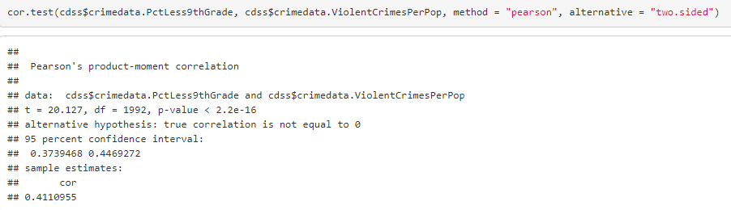
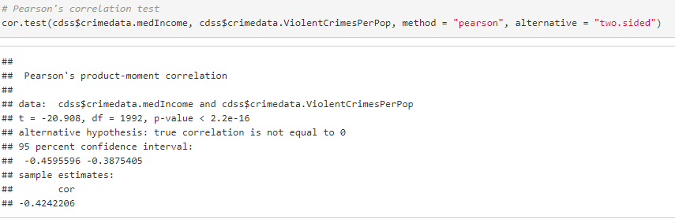
Pearson’s Correlation
% Less than 9th Grade Education correlation to Violent Crimes per population is moderately correlated at 0.411
Median Income shows negative correlation at -0.424
All there predictors were less than 0.2 in correlation.
Notes:
Running the correlation code, we were able to get an idea of the correlation between violent Crimes and several predictors. But given the number of predictors we had available, Random Forest was the best predictor of importance.

Slide 9
Order of Importance
Notes:
Study: Crime rates linked to out-of-wedlock births
July 6, 2010, University of Chicago
(PhysOrg.com) -- A study in the latest issue of The Journal of Law and Economics finds a link between out-of-wedlock births and rates of murder and other crimes.
According to the study, in the years from 1965 to 2002, higher rates of out-of-wedlock births in a given year correlate with higher crime rates roughly 20 years later, when members of that birth cohort had become adults. The findings suggest that children born out of wedlock may receive lower educational and other resource investments from their parents, and may therefore be more likely to commit crimes as adults, say the study’s authors, economists Todd D. Kendall, of the consulting firm Compass Lexecon, and Robert Tamura of Clemson University.
“While a number of previous studies have found that unmarried fertility is associated with unfavorable childhood outcomes, our analysis is one of the first to measure the long-run effect on crime when these children reach adulthood,” Kendall and Tamura write.
According to the analysis, an increase of 10 out-of-wedlock births per 1,000 live births was associated with up to a 5 percent increase in future murder rates. The researchers find that most of the large increase in the number of murders in the U.S. during the 1970s and 1980s can be explained by out-of-wedlock births.
The study used crime statistics and birth records from 1923 to 2002 in the 32 U.S. states that record the marital status of parents.
ROLE OF SOCIAL STIGMA
While Kendall and Tamura found that more out-of-wedlock births are associated with higher subsequent crime rates over the last 45 years, they found just the opposite for years prior to 1965. In the 1940s and 1950s, small increases out-of-wedlock births actually correlated to lower subsequent murder rates.
Why did the association change? Kendall and Tamura argue that changing social attitudes toward unwed motherhood are the primary reason. In the 1940s and 1950s, social stigma against unwed mothers was intense, and as a result most pregnant couples ended up getting married—even couples who were very poorly matched. Some of those marriages would have been so bad that the children involved might have been better off—and less inclined to commit crimes as adults—if their parents had never married. So a moderate increase in out-of-wedlock births during this period meant that fewer poorly matched couples were forced to marry, thus exposing fewer children to damaging marriages.
In the 1960s and 1970s, however, social attitudes toward unwed motherhood changed rapidly and rates of out-of-wedlock births skyrocketed. Many of the marriages foregone during this period would have been relatively well-matched couples, Kendall and Tamura argue. “The children of these higher-quality matches are worse off because of their parents’ failure to marry, and have higher risks of adult criminality,” they write.
ABORTION AND CRIME
In 2001, economists John Donohue and Freakonomics author Steven Levitt published a controversial paper linking lower crime rates in the 1990s with the legalization of abortion 20 years earlier. Donohue and Levitt contend that abortion lowered crime rates because many children who would have become criminals as adults were never born. Some commentators pilloried the study as implying that society benefits from abortion.
Kendall and Tamura’s study supports the idea that abortion does reduce future crime, but shows that the primary cause of this effect is the reduction in children born to unmarried parents. “Our findings suggest that promoting marriage among new parents could be as effective in reducing crime as loosening abortion restrictions,” Kendall said. “We show that abortion is a blunt policy lever for affecting crime rates.”
More information: Todd D. Kendall and Robert Tamura, "Unmarried Fertility, Crime, and Social Stigma." Journal of Law and Economics 53:1.
Provided by: University of Chicago
Read more at: https://phys.org/news/2010-07-crime-linked-out-of-wedlock-births.html#jCp

Slide 10
Findings
Notes:
Every child deserves a chance to be loved and to follow their dreams. Children can enter into this world into a wide variety of family environments. With the increases of cohabitation in relation to marriage, however, the amount of children who fill up the illegitimate birth statistics is beginning to rise.
In the United States, over 40% of the total births that occur annually are considered illegitimate births.
Illegitimate Children Facts
One of the biggest risk factors that contribute to the rise of illegitimate births is income. When people are struggling financially, then there is a direct connection to the illegitimacy rate for their demographic. Other influences include the exposure to crime and low levels of education. Because these trends tend to affect certain racial demographics more than others, there is a definite disparity in these figures.
Where Are Illegitimate Births Happening?
Nearly 3 out of every 4 children that are born to an African American mother are born out of wedlock.
The percentage of children born out of wedlock to Native populations: 66.2%.
The lowest rate of illegitimate births comes from Asian and Pacific Islanders, at just 17.2% of all births.
In the last year, there were over 1.6 million live births to unmarried women.
The birth rate for unmarried women aged 15-44: 45.3 births per 1,000 women.
The place in the US that sees the most illegitimate children born is the District of Columbia.
The state with the lowest illegitimate birth rate: Utah at just 14.7% of all births.
72.3 percent of non-Hispanic blacks are now born out-of-wedlock.
Of every 1000 children born, 30 born to white women were born out of wedlock, while black women gave birth to 70 out of wedlock children, and Hispanic women to 100.
There are a number of factors that are contributing to the rise of illegitimate births. Money is obviously one major consideration. It’s actually cheaper in some ways to cohabit than it is to get married, even if a couple skips the large ceremony for a basic meeting with the local Justice of the Peace. It’s also a reflection of changing times, where people are more willing to shed the commitment of marriage in order to have a level of personal independence while still committing to a relationship. This isn’t a recent trend. Non-marital fertility rates have been climbing steadily since 1940.
What Increases The Risks Of An Illegitimate Birth?
57% of women who gave birth to a child when they were not married did not have a high school diploma.
Living below the state’s median income level increases the chances of having an out of wedlock birth by 67%.
As income levels increase, the rates of illegitimacy drop. For households that earned at least $200k, the illegitimate birth rate was just 9%.
Up to 40% of children today will live in a cohabiting household by the age of 12.
The illegitimate birth rate for women making less than $10k per year: 68.9%.
Only 8.8% of the total illegitimate births were to women who had a 4 year college degree in any subject area.
The statistics here are clear. When there is more money involved, then there are fewer illegitimate births. When there is more education involved, there are fewer illegitimate births. This means that the easiest and fastest way to reduce these rates would be to work on improving the standard of life for women who are living in poverty right now. Even the simple act of getting a GED lowers the risk of a woman becoming pregnant while out of wedlock.
Is Age Also A Risk Factor For Illegitimate Children?
For the number of new mothers that were aged 15-19, over 86% of them were not married.
Only 31.9% of women aged 25-29 who gave birth to a child over the past year were not married.
The only time the percentage of unmarried women climbs is when a woman gives birth in her 40’s.
Children who are born to women who are unmarried are more likely to grow up in a single-parent home than children born to married couples.
Between 2006-2010, 58% of births to unmarried couples were to cohabiting parents, an increase of 18% from just 2002.
Under the age of 15, there is a 99% chance that a birth will be to an unmarried mother.
The fastest growth rates for age demographics with illegitimate children are the 30-35 year old group.
Trends are shifting for unmarried mothers. Although it makes sense that most teen moms aren’t going to be married, they aren’t the fastest growing demographic. Women who are likely in the middle of their career are the fastest growing demographic in this area and the data shows that cohabitation is likely responsible for it. With up to 85% of cohabiting couples breaking up within a 5 year period, the issue isn’t the quality of parenting. It’s whether or not a child who grows up in this environment will have the same advantages as a child growing up in a two-parent married household. The data suggests that the illegitimate child is going to face a tougher journey through childhood.
Have Illegitimate Births Reached Crisis Levels?
The median age for a woman to become a mother: 25.7 years.
Living the Middle Class lifestyle means needing more education than ever before, which is causing couples to put off getting married more often.
Cohabiting couples are less likely to have job prospects or economic stability.
Only 38% of American women will be married by the time they reach the median age of motherhood.
For women who have a high school diploma and some college, 58% of the births to this group are considered illegitimate children.
If a couple is living together when they have a child, but not married, then there is a 39% chance of the family unit disintegrating. It’s just 13% for a married couple.
Maybe some families are staying together for their children when they are married. The same could also be said for cohabiting couples. Now all of this data doesn’t prove that an illegitimate child isn’t going to be successful. It just means that the data shows there are higher failure risks involved than there are for children who are born to couples that are married. If we can stabilize our society and get good jobs available, then these rates just might drop and that might mean kids will be able to make even more incredible advancements as they turn into adults. One thing is for certain: children are our future. We need them more than they really need us.

Slide 11
conclusion

Slide 12
Citation
U. S. Department of Commerce, Bureau of the Census, Census Of Population And Housing 1990 United States: Summary Tape File 1a & 3a (Computer Files),
U.S. Department Of Commerce, Bureau Of The Census Producer, Washington, DC and Inter-university Consortium for Political and Social Research Ann Arbor, Michigan. (1992)
U.S. Department of Justice, Bureau of Justice Statistics, Law Enforcement Management And Administrative Statistics (Computer File) U.S. Department Of Commerce, Bureau Of The Census Producer, Washington, DC and Inter-university Consortium for Political and Social Research Ann Arbor, Michigan. (1992)
U.S. Department of Justice, Federal Bureau of Investigation, Crime in the United States (Computer File) (1995)
https://brandongaille.com/27-enticing-illegitimate-children-statistics/
https://phys.org/news/2010-07-crime-linked-out-of-wedlock-births.html
http://digitalcommons.law.yale.edu/cgi/viewcontent.cgi?article=1018&context=lepp_papers
Redmond, M. A. and A. Baveja: A Data-Driven Software Tool for Enabling Cooperative Information Sharing Among Police Departments. European Journal of Operational Research 141 (2002) 660-678.

Slide 13
Hypothesis
Hypothesis
Critical Value
P-Value
Decision:
Conclusion

Slide 14
Assumptions
Linearity – Met with Log-Log model
Normality – Log-log model looks slightly better
Equal Standard Deviations – review residual plots
Independence –We assume independence.
Outliers – There are no major outliers
Inference -

Slide 15
Appendix

Slide 16
Study: Crime rates linked to out-of-wedlock births July 6, 2010, University of Chicago
(PhysOrg.com) -- A study in the latest issue of The Journal of Law and Economics finds a link between out-of-wedlock births and rates of murder and other crimes.
According to the study, in the years from 1965 to 2002, higher rates of out-of-wedlock births in a given year correlate with higher crime rates roughly 20 years later, when members of that birth cohort had become adults. The findings suggest that children born out of wedlock may receive lower educational and other resource investments from their parents, and may therefore be more likely to commit crimes as adults, say the study’s authors, economists Todd D. Kendall, of the consulting firm Compass Lexecon, and Robert Tamura of Clemson University.

Slide 17
Single Parent Households
Children in single-parent households are burdened not only with profound economic disadvantages, but are also far likelier to eventually get into trouble with the law. As a Heritage Foundation analysis notes, youngsters raised by single parents, as compared to those who grow up in intact married homes, are much more likely to be physically abused; to be treated for emotional and behavioral disorders; to smoke, drink, and use drugs; to behave aggressively and violently; to engage in criminal activity; and to be arrested for a juvenile crime. According to the National Fatherhood Initiative, 60% of rapists, 72% of adolescent murderers, and 70% of long-term prison inmates are men who grew up in fatherless homes.
http://www.discoverthenetworks.org/viewSubCategory.asp?id=1636

